Slide 1
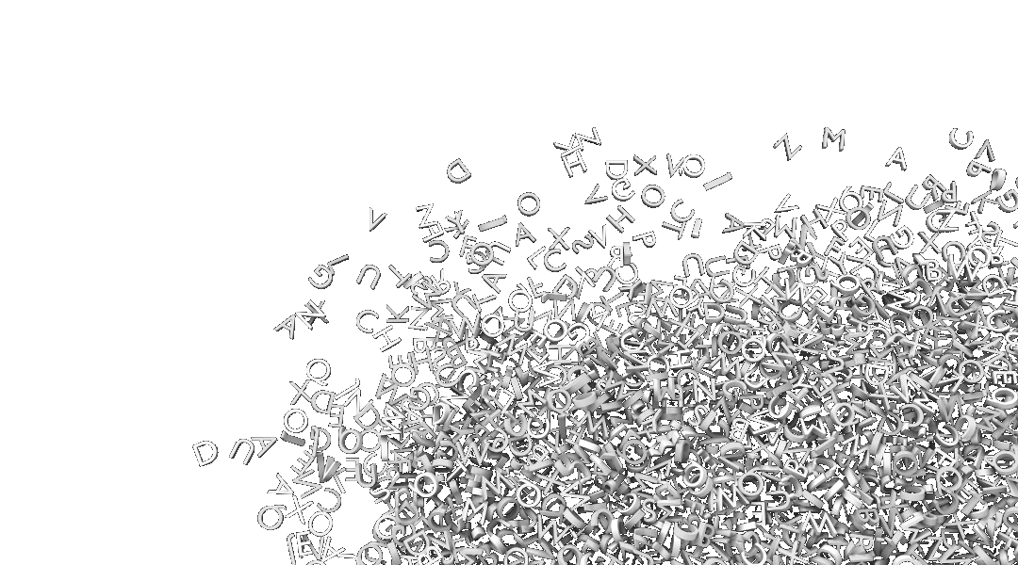
Epic
Interactive Fiction
Group 34
Carson Stevens, Scott Oelkers, Skyler McMullen, Jonathon Kastner, Cameron Do
Notes:
Sha Boi

Slide 2

Epic: An Interactive Text Generation Tool
Give Epic a genre, a style of author, and a desired level of creativity
Generate a personalized story that fits your parameters
Epic will finally make your writing pretty good
No more boring campfire stories!
No more disappointing your family!
Epic
But writing is hard?
Want to entertain them with your amazing fictional writing?
Bored in quarantine?
Disappointing your family?
Introducing
Notes:
Sha boi
The problem you are trying to solve, and why you chose that problem
Any necessary background info needed for your audience to understand the problem

Slide 3
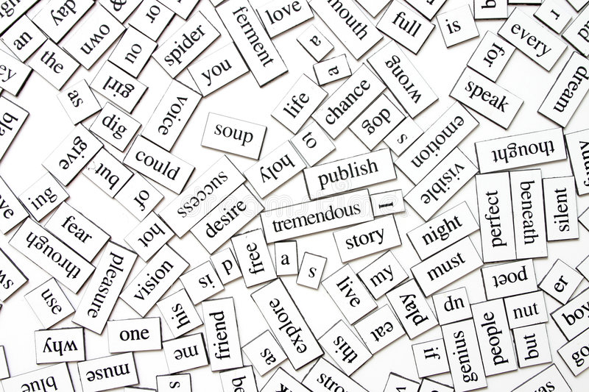
The Dataset
~75mb of horror fiction text (~50,000 pages)
Public domain novels, movie scripts, short stories, etc.
53 Authors
117 Individual Works
Blacklist File
Set of excluded words when generating output
(harmful or profane words)
Notes:
Jon

Slide 4
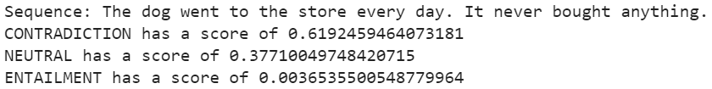
The Models
GPT2
Transformer based language model
Predicts the next word in a sequence given the current context
Roberta Large XNLI
Zero-Shot Text Classification
Entailment, Contradiction, Neutral Analysis
BERT Base Multilingual Uncased Sentiment
Sentiment Matching / Analysis
Notes:
Carson
give details as much as this medium and time allow, e.g., the printed output from model.summary() if you are using a modest-sized NN built with Keras

Slide 5
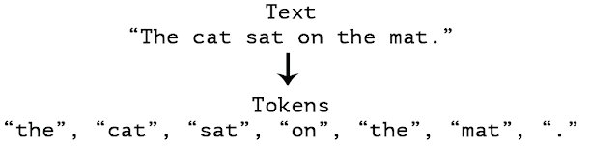
Data Cleaning / Tokenization
Clean text files
UTF8 format
Page numbers
Extra white space
Identified special tokens
Data, Literary and Genre
Give the model added context
Prepend special tokens to every line
Zero-Shot tokenizer
Notes:
Scott I’ll have you know my mom finds me very handsome

Slide 6
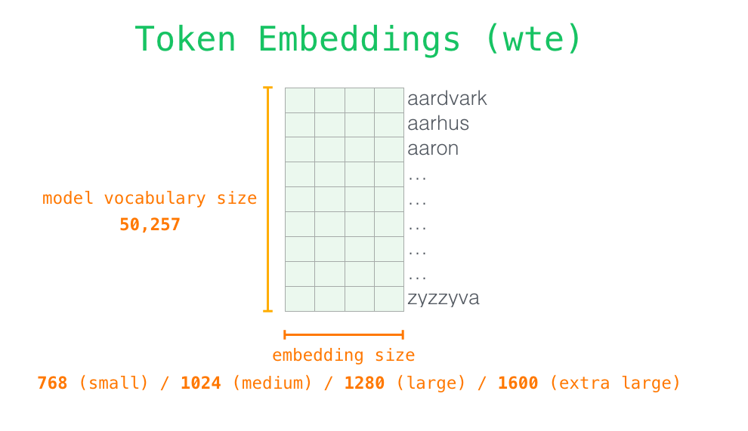
Training the GPT2 Model
Feature Learning
Features stored in the GPT2 model’s vocabulary
Each feature is a unique word vector in the model’s token embedding
Data Splitting
70% training, 10% validation, 20% testing
Notes:
Nam
Feature learning, if any (and why is was or wasn't used)
Splitting of data into sets: Train/validation/test, k-fold cross-validation, or something else

Slide 7
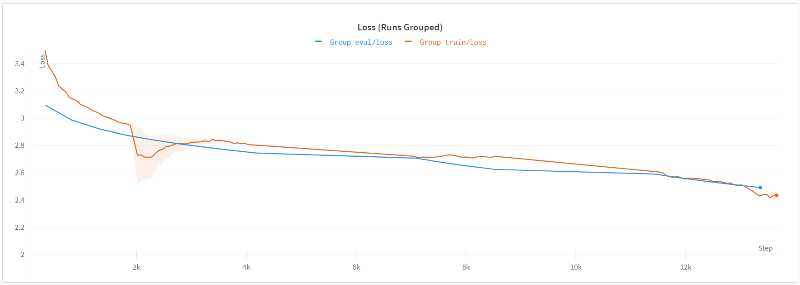
Model Performance

Slide 8
Model Evaluation
User
User
Model
Model
Input
Input
Output
Output
Sentiment and Contradiction Analysis
Evaluate the predicted output
Return if passes acceptance criteria
Acceptance criteria:
Predicted output resembles the sentiment of the user’s input
Predicted output does not significantly contradict the user’s input
Sentiment Classifier
★ - 0.012
★★ - 0.248
★★★ - 0.820
★★★★ - 0.536
★★★★★ - 0.150
★ - 0.253
★★ - 0.759
★★★ - 0.548
★★★★ - 0.123
★★★★★ - 0.034
abs(★★★ - ★★)
if ≤ 1
Contradiction Classifier
if “contradiction” < 0.8
Return output
Notes:
Sha boi what up nerd.
Describe the method you chose to evaluate your model(s), and why you chose that method
Present the evaluation scores or other assessment. Use visuals - line plots, bar plots, etc.
Evaluating the output of our model is somewhat of a subjective task. After all, what we’re after here is generating new text that has not been written before and might even be interesting. It’s not so easy to come up with a metric for how interesting your model is. What we decided was to classify the sentiment of our output, using a sentiment classification model which was trained on amazon reviews. This model takes in a sequence and outputs the classifications in the range of 1 to 5 stars along with the scores of those classifications. We determined the sentiment of the user’s input, and if the sentiment from the predicted output of the model was similar to the input (within a 1 star rating) then that output was accepted. Additionally, we classified the contradiction of our outputs using a similar model that was trained to classify contradiction and entailment. If the output did not significantly contradict the user’s input, then it was accepted. The evaluation methods improved the generation in our model.

Slide 9
Demo
Notes:
Carson

Slide 10
Conclusion
Did you achieve what you'd hoped? Why or why not? What would you have done differently? What would you have done next?
Notes:
Nam

